Slide 1
Research Module A practical guide on how to plan for, conduct and report a single case experimental design for the CAP training programme
Stephen Kellett, Chris Gaskell & Mel Simmonds-Buckley
Clinical and Applied Psychology Unit
University of Sheffield
March 2021

Slide 2
OVERALL AIMS OF THE WORKSHOP
To become familiar with the requirements of the single-case experimental design submission on the CAP course
To appreciate the linkage between practice-based evidence and single case methodology
To understand the basic features of the available designs
To consider ways of making single case work more accessible to your client
To appreciate the potential of single case methodology

Slide 3
OVERALL AIMS OF THE WORKSHOP
To review the application of single-case methodology within clinical research and practice.
To examine practical difficulties arising from the implementation of single case studies.
To provide practical experience of design and analysis of single case studies.
To provide a forum for you to discuss foreseen problems associated with single case design and to problem solve these with you.

Slide 4
PROGRAMME
First day: SCED rationale, design and measures
Overview of uses and applications of SCED
Basic principles.
Modelling and role play of designing measures for a single case study.
How to implement - designs and measures.

Slide 5
Evaluating what?
You need to complete a SCED of the delivery of the Unified Protocol with a service user
Any SCED design is permissible – be creative – and we will teach you all the methods
Submit via Unidrive and not Turnitin.
There is ethical approval for this in place
The patient information and consent forms are on MUSE – the appendix of the submission needs the signed consent form.

Slide 6
PROGRAMME
Second day: evaluation and interpretation
Approaches to evaluation – both visual and statistical.
Practicing analysing different types of single case data using some SCED software
Look at the data generated and interpret it

Slide 7
So why use SCMs?
Clinical research: testing clinical hypotheses and contributing to knowledge.
Practice philosophy: being a scientist practitioner.
Accountability and evaluation: the effective practitioner and auditing your work.
Education and training: learning SCED skills for the rest of your career.

Slide 8
How successful has SCM been as a research tool?
Real contribution to science.
Steady stream of single case texts published.
Many major advances in psychotherapies originally published originally as SCM pilots (e.g. CBT and panic/psychosis)
Big acceptance of SCM within medicine
Recent trends are away from Applied Behaviour Analysis applications to more general evaluations of therapy across a wider range of clinical problems
Less sophisticated designs tend to be employed
Wider range of more appropriate statistics available and packages that support them

Slide 9
CLINICAL PRACTICE
Accountability and evaluation
Demonstrating treatment effectiveness to a client or a clinical team or a family (e.g. enhancing "self efficacy" and client's involvement / compliance with treatment).
Training in single case methods makes more effective practitioners?
Referral on following ineffective treatment – you will really know this

Slide 10
Single case defined as:
The repeated collection of quantifiable (numerical) data on a single clinical case, always involving repeated measurement over a baseline period
Experimental manipulation through some form of introduction or withdrawal of an intervention and the changes assessed against the baseline.
Characteristics intended to help the clinician rule out alternative explanations for a finding by focusing on within-subject variability and to seek to understand and explain the causes of that variation
Such an approach may or may not include replicating the design over several cases to form a single-case series (CAPs not required to do this)
Qualitative approaches can also be profitably applied to the single-case design. The collection of rich, detailed qualitative information throughout the course of treatment can prove useful in helping to rule out alternative hypotheses

Slide 12
Where is the focus?
Your individual service user
You, the apprentice CAP
Why and what leads to change in this client?
Within client variability and change rather than across groups of clients

Slide 13
What’s the advantage of SCED?
Low cost
Low infrastructure
Small ‘turning circle’
Easily adaptable
Flexible methods

Slide 14
Why is SCED useful?
Perhaps the most useful contribution the single-case design can make to efficacy-effectiveness research is its ability to answer questions that are clinically relevant variants on those of evidence-based practice:
Does this evidence-based treatment work for this particular type of client, who differs in some way from the sample characteristics of the evidence base?

Slide 15
So why don’t clinicians use it?
Lack of confidence
Lack of knowledge
The ideal described in the classic texts on the design seems a far cry from what is possible in the real world

Slide 16
How to engage clients
Not a must do aspect of your work
Have a relaxed attitude
Display interest in their plight
Be flexible
This is an aspect of your normal practice
Encourage reflectivity
Keeping an eye on progress
Promise feedback

Slide 17
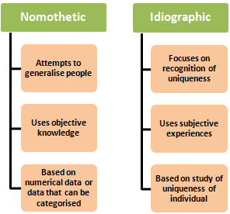
SCED balances nomothetic and idiographic approaches to measurement

Slide 18
Defining feature: repeated idiographic measurement
A funnel approach from nomothetic to idiographic target measures
Usually single case designs rely either on direct staff/parent/carer observations OR self-monitoring using self-report diaries.
Frequent measurement of idiographic outcome measures that are key to the maintenance of the clinical problem
The repeated idiographic measures provide data on the variation across time in these outcome. With this information the search can begin for the causes of that variation
In essence, you then ask to what extent the observed variation in the idiographic measures is consistent with change occurring?

Slide 19
What is a baseline?
A baseline ‘A’ involves taking repeated measures of the idiographic measures before treatment occurs - so that the ‘natural course’ of the outcome is known
In terms of the ideal, long and stable baselines are considered helpful – but not that common.
Technically neutral baselines are a fallacy – you have contact with the service user; you are assessing them.
Some disorders have inbuilt variability, so don’t expect a stable baseline

Slide 20
So, why is baseline stability an issue?
A worsening baseline: sudden, dramatic worsening of symptoms may represent a temporary change that would dissipate regardless of any intervention
An improving baseline: problematic, because any subsequent improvement during the intervention phase may have occurred whether or not the intervention was introduced

Slide 21
Baseline-practical issues
Suitable baseline: the assessment phase
Identify a small number of target variables during the assessment and then generate a brief rating scale, which the client would complete daily over time

Slide 22
STABLE BASELINES
Baseline should be stable (mean level) with low variability.
Problems arise if baselines display:
(i) Linear trends:
(ii) Higher order trends
(iii) High variability
Presence of (i), (ii), or (iii) makes both visual or mathematical analysis more difficult.

Slide 23
BASELINE REQUIRMENTS
What are the minimum requirements for a baseline?
Number of observations? 14 DAYS
Stability? Sidman suggests collecting data until a stable baseline is achieved. Stability is defined 5% variability around mean value.
Remember. Your baseline measures should continue throughout your intervention and be repeated at follow up.
When does the baseline start and end? In the UP, the baseline (A) would end once you have the formulation in place. Start of module 1 is start of treatment (B). The UP formulation goes in the appendix of the piece of coursework.

Slide 24
Designing idiographic measures: tips
Designed collaboratively
In the client’s language
Can be a piece of cognition, behaviour, affect or interpersonal process (or a variety of these; topographical variation)
Anchored and scaled effectively – in the clients own words
High frequency occurrences are best
Intensity measures
Frequency measures
When to complete?
What time period do they cover?

Slide 25
Consider having a control idiographic measure
These are an idiographic measure, not expected to change due to the intervention
If there is change in the target idiographic measures and not the control is shows the intervention working.
Stability also shows its not spontaneous recovery

Slide 26
Modelling and role play
Lets decide as a group what the client will be presenting with and in what context
What the demonstration and then we can critique it
Then you will get to practice in 2s – you both have a go.

Slide 27
Choosing nomothetic measures
These are the psychometrics that are off the shelf and you use them at pre and post intervention
Do them at the end of follow-up if you have that in your design
Do them at the end of each phase if you are doing more than a A/B
Try to match one the nomothetic measure to the presenting problem
You need to use the CORE-OM at least.

Slide 28
Choosing a generalisation measure
Whilst the intervention should influence the target of the intervention, an important issue is whether the intervention generalises to other aspects of the client’s life.
These measures are good test of the external validity of your work.
You take these measures (e.g. quality of life) occasionally and often in tandem with the nomothetic outcomes measures.

Slide 29
Treatment
Involves the introduction (and/or withdrawal) of the UP so that its effect on the idiographic measures can be assessed
The UP you deliver needs to be well specified
Take all of this – the design and the intervention to supervision.
Tape a treatment session and get your supervisor to rate your clinical competency with the CTS-R and you can report that in your method – that would add to the write up (but isn’t a must do).

Slide 30
CHOOSING AN APPROPRIATE DESIGN
The choice of design determines the internal and external validity of your single-case study.
Important to be aware of what is possible in terms of a design
Ask - am I being ethical and so are reversals or withdrawals appropriate?
Important to know the methodological features before you start (see the later planning slide)

Slide 31
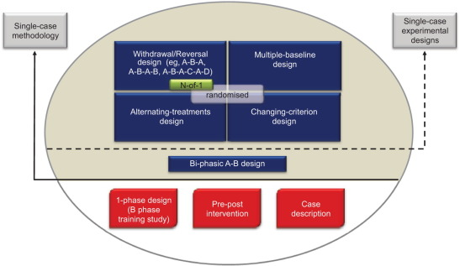

Slide 32
The A/B design (see the CBT example with an older adult in your pack)
The A/B design is the most basic approach to single-case research. It involves a baseline period (termed A), during which measures are taken repeatedly, and a subsequent intervention period (termed B), during which measurement continues
Improvement on simple pre-post design
It is in terms of the research ideal the weakest strategy, because it leaves open so many alternative explanations for any observed improvement in symptoms
Not a SCED, but a quasi-experimental design

Slide 33
Consider having a follow-up phase
This would make it an A/B + FU design.
You can compare baseline to treatment and then stability of change in a treatment versus follow-up comparison.
This is a slightly stronger design.

Slide 34
Withdrawal designs A/B/A (see the CAT for BPD example in your pack)

Slide 35
CHANGING CRITERION DESIGN

Slide 36
ALTERNATIVE TREATMENT DESIGN: A/B/C See the compulsive buying example ABC in your workshop pack
Presence/opportunity to engage in two or more treatments – you would need to have a baseline, a phase of the UP and then another treatment.
Which treatment is most effective?
Problems: Is seldom employed for psychotherapy.

Slide 37
THREATS TO THE VALIDITY OF YOUR SCED
1. History (extraneous concurrent events)
2. Maturation (spontaneous recovery)
3. Testing (reactivity and the mere measurement effect)
4. Instrumentation (reliability)
5. Multiple intervention problems (can a psychotherapy be withdrawn)?
6. Instability

Slide 38
Problems with withdrawal designs
Non-reversible treatments:
therapeutic instructions (e.g. self-control / management strategies)
CAP/client expectations/interactions;
long-acting pharmacological interventions;
altered environments;
altered staff attitudes.
Carry-over effects between the phases.

Slide 39
Problems with withdrawal designs
Ethical / clinical problems:
Prior agreement with client / staff needed,
Client consent and general ethical issues
Ethics of accountability and evaluation
Relatively brief withdrawal phase and rapid re-instatement of treatment
Problem of client's expectations and adherence to withdrawal
Treatment holidays?

Slide 40
The 8 treatment modules in the UP
Borkovec and Castonguay (2006) point out, the use of mini-interventions in which circumscribed components of treatment are actively manipulated is an underused research strategy, but one that offers the opportunity to increase our knowledge of basic change mechanisms in psychological treatments.
Separate out the modules on the time series graphs and test for an effect.
Submit the excel sheets as part of the submission showing each module and the scores on the idiographic measures during the phases

Slide 41
Planning your design – what to consider; write a plan and take it to supervision
The type of design
The number of sessions in each phase and module
How the phases will be sequenced with the modules
Frequency of the idiographic measures
Frequency of the nomothetic and generalisation measures
Frequency, duration, place and time of sessions
Baseline fidelity (be able to describe in full detail)
Treatment fidelity (how to keep everything the same bar starting treatment).

Slide 42
STAGES TO SCED
IDENTIFY QUESTION AND HYPOTHESIS.
SELECT APPROPRIATE DESIGN AND MEASURES.
IDENTIFY MATERIALS AND RESOURCES.
COLLECT DATA/ SUPERVISE STUDY.
ANALYSIS.
INTERPRETATION.
COMMUNICATION.
These stages may need to be considered collectively and not in isolation. For example. The level of communication of findings may determine the level of analysis adopted.

Slide 43
IDENTIFY CLINICAL QUESTIONS AND HYPOTHESES
Have you a clear UP formulation in place?
Have you got the books!?
Is the treatment compatible with the therapy as described in the treatment manual?
State the hypotheses clearly!
State any therapeutic predictions clearly!

Slide 44
IDENTIFY MEASURES
What measures are required to assess therapeutic aims and goals?
Ensure measures are suitable for SCED. In practice this usually means observational measures such as time sampling and staff checklists on in-patient wards; daily diaries of symptoms, functioning, problem resolution; regular use of short psychometric questionnaires etc.
Ensure rating scales are unambiguously worded and are anchored and well described.

Slide 45
IDENTIFY MEASURES
Ensure that diaries are well laid out and well presented. Scraps of paper do not value people and are seldom completed!
Try to use a page a day to record ratings - avoid weekly sheets.
Consider using a combination of measures targeted at both symptoms and functioning.
Consider several sources of measurements: client and partner/carer, child and parent,
Consider adding a follow ups phase; A/B-FU design

Slide 46
MATERIALS AND RESOURCES
Ensure measures are acceptable/appropriate for client, or staff or carer or partner.
Plan for study to fit into clinical practice: baseline collected across sessions 1-2, intervention starts session 3, 16 sessions of therapy contracted, follow ups at 6 weeks and 6 months?
Ensure adequate resources - staff properly briefed, supervisor aware of coursework (especially to them), new staff on wards are briefed.

Slide 47
MATERIALS AND RESOURCES
If staff are collecting the data do they understand the design rationale and do they need any training?
Data is being recorded and stored reliably (i.e. it is being written down in a retrievable manner, it is not missing and is confidential).
If appropriate, staff should receive ongoing feedback about progress of the case (i.e. regular review meetings) and this be reported in the method.
What are the consequences of diverting resources to this project in relation to other ongoing clinical work? Is it feasible in the setting your working in?

Slide 48
INTERPRETATION
What are the main changes or effects?
How do they correspond to predictions?
Are they valid given the design?
What alternative explanations (i.e. threats to validity) are there?
Are the effects reliable or clinical significant? Are they noticeable to therapist, client or others?
Are they generalizable or clinically replicable?
If effects are clinically nonsignificant - what explanations exist?

Slide 49
COMMUNICATION AND DISSEMINATION
Share the findings with the client or the staff or both.
Thank client and staff.

Slide 50
What can you submit?
The design of the submission needs to either be quasi-experimental or a SCED. The design of quasi-single case experiments is A/B.
It is advantageous but not necessary to have a follow-up phase (i.e. an A/B-FU design) in which the idiographic measures continue to be collected and the nomothetic measure(s) are collected at the final follow-up.
CAPs are also encouraged to consider completing a true SCED in which a cross-over design is used (e.g. A/B/C where B is the UP and C is CAT) or where there is a treatment removal component (i.e. ABA, or ABAB).
All designs need to be agreed in clinical supervision, and treatment withdrawal particularly considered due to the associated ethical issues.

Slide 51
How to do a good piece of coursework
The structure is (4,000 words):
Title
Introduction, aims and hypotheses
Methods
Results
Discussion
References
Appendices (not in the word count)

Slide 52
Its helpful to know the reporting standards for SCED
Look in the resource pack and its there! (SCRIBE guidelines)
This will help you write inclusively.
Read this before planning a case too!

Slide 53
What goes in the introduction?
Concise summary of relevant background literature about the UP and how it relates to the case.
Consider and refer to relevant NICE guidance if available.
Provide focus of present case study briefly mentioning rationale and approach and end with specification of hypotheses according to design.

Slide 54
How to write the methods
Outline of rationale and design of SCED, brief and confidential description of client (presenting problem/diagnosis/previous service usage/current medication), service, supervision, and your details.
Describe the idiographic measures and the data collection methods (e.g. observational schedules, self-monitoring diaries completed by the client) and the analysis strategy being used and naming the package being used.
List and provide evidence of the psychometric properties of nomothetic measures used and the analysis strategy being taken (e.g. RCSC).
A three-column treatment adherence table should be provided detailing the session number, UP module, clinical content of that session.
Report any competency checks done by your supervisor.

Slide 55
Session | Phase of study and module | Content
Session 1 | A: Baseline | Assessment of current functioning
Session 2 | A: Baseline | Assessment of developmental history and formulation produced
Session 3 | B: Module 1; motivation enhancement | Balance sheet and goals
Session 4 | B: Module 2; understanding emotions | Completed 3 system analysis and agreed homework
Sessions 5 and 6 | B: Module 3; emotion awareness | Completed and analysed two ARCs and agreed homework

Slide 56
What goes in the results?
Present the idiographic results first in the form of time series graphs for each measure that show each of the phases of the study. Days not sessions on the horizontal axis and scores on the vertical axis.
A baseline median trend line should be fitted and also trend lines fitted for each phase.
Baseline phases should be assessed for trend using both visual analysis and statistical analysis (e.g. Tau). When significant baseline trend arises, statistical analyses which adjust for baseline trend should be employed (e.g. Tau-U). Individual study phases should also be assessed for serial dependency (autocorrelation).
Present a table of means (SD) for each idiographic measure for each phase of the study.

Slide 57
What goes in the results?
Idiographic outcome measures should be assessed for between phase change using a minimum of three nonoverlap tests (e.g. PND, PEM, PAND, NAP, IRD). These findings should be reported in a table and interpreted using the established guidelines.
The scores on nomothetic measure(s) should be presented in a table for each time point.
This table also contains reliable and clinical change analysis and also the relevant clinical and community norms on that measure.
If there is a sessional nomothetic outcome measure then that should be graphed at each session.

Slide 58
What goes in the results?
Additional or supplementary data and graphs can be appended to the report after the reference section.
When statistical analyses are reported, ensure sufficient details (t values, d.f., means and SDs of groups, etc.) for their interpretation are provided.
Graphs within the body of the text should be of a high standard of presentation and clearly labelled.

Slide 59
What goes in the discussion?
The findings should be discussed in relation to the original hypotheses.
Please ensure that you relate the results obtained to the design employed.
Consider the generalisability of the intervention effect.
A critical review of the methods, design and analysis employed should be presented.
Please comment on any relevant organisational and ethical issues surrounding this clinical study. The clinical significance of the study should also be addressed.

Slide 60
What goes in the appendices?
UP formulation
Examples of the idiographic data collection tools (e.g. observational schedules by staff or patient daily diaries) should be placed in the appendices and care should be taken to ensure that they are anonymous. Redact personal information.
As the UP is a modularised approach, the CAP trainees should also submit an excel sheet in which the idiographic measures are clearly labelled in terms of dates of completion by the service user and the progression through the UP modules.
The signed consent form

Slide 61
CONCLUSIONS
SCED can be used in a wide variety of situations and these range across service users and settings.
CAPs as a scientist-practitioners – a good place to be.
Integrate the methods into your practice – don’t be anxious.
Always start with the baseline - the design can evolve and be flexible
Remember to remember your client - your job is to help then and not manipulate variables and phases
Play around with the methodology

Slide 62
How to analyse and interpret SCED data?
Day 2

Slide 63
Recap from Day 1
Introduced rationale and applications of SCED
Aware of different types of SCED design
How to design and implement measures

Slide 64
Plan for Day 2
Evaluation and interpretation
Visual analysis and interpretation
Statistical analysis and caveats
Assessing nomothetic outcomes
How it fits with your assignment
SCED analysis software and resources
Practical exercise: Have a go at some analysis!

Slide 65
Key features of SCED analysis
SCEDs are fundamentally different to group-based research
Group research -> averages/combined findings/overall effects
SCED -> raw data/stability, variability, trends/individual effects
Visual analysis – this is the main analysis!
Plot and analyse time series data visually
Statistical analysis
Use statistics to confirm visual analysis
Never interpret SCED statistics in isolation – viewed alongside visual plots
Be aware of the limitations of statistical analysis in SCED

Slide 66
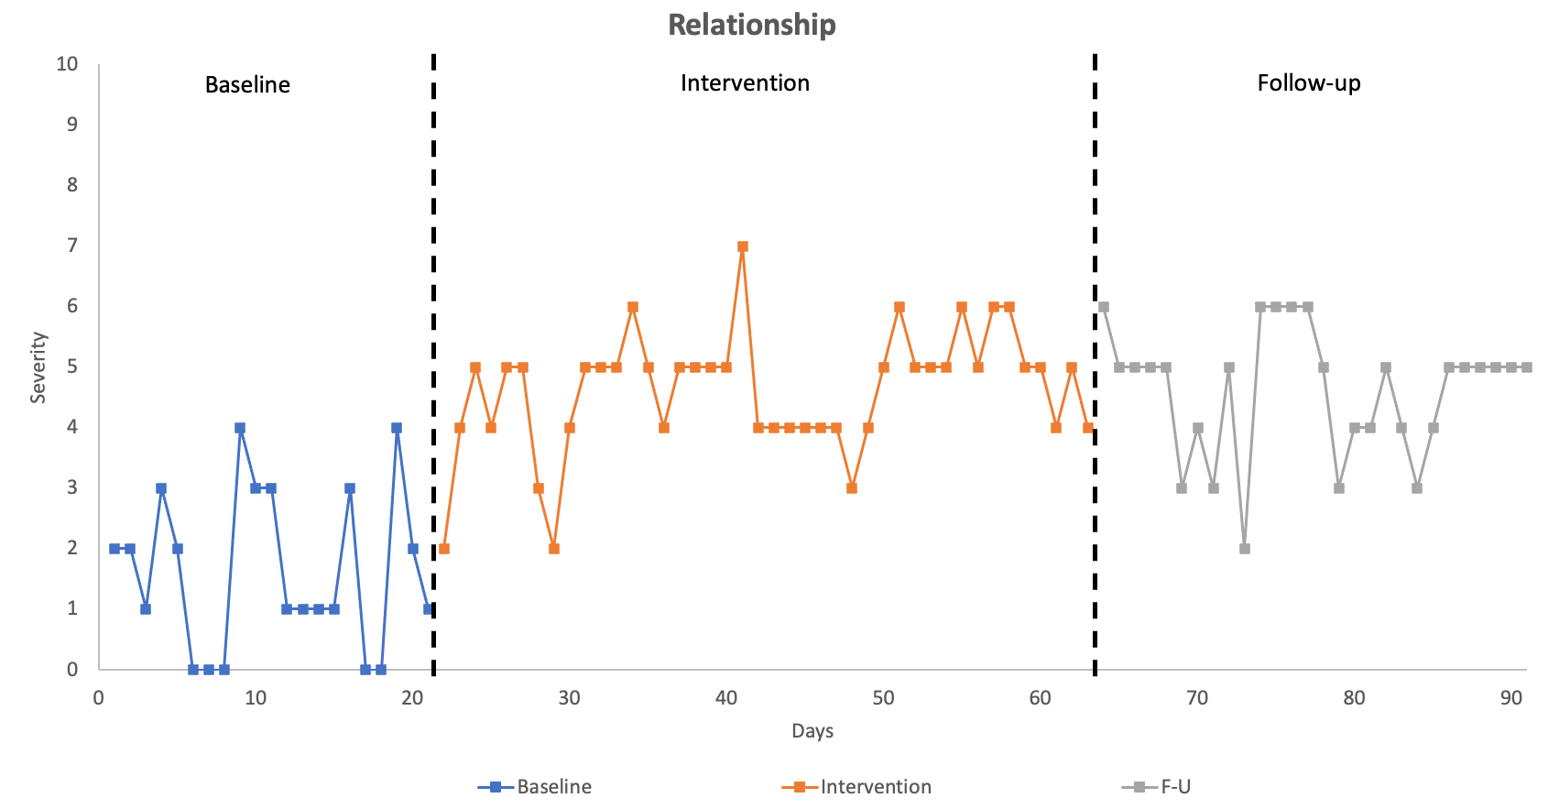
Visual analysis
Depict phases with vertical lines intersecting the X axis
Plot each idiographic measure in a time series graph
Severity/score on vertical Y axis
Time points along the horizontal X axis

Slide 67
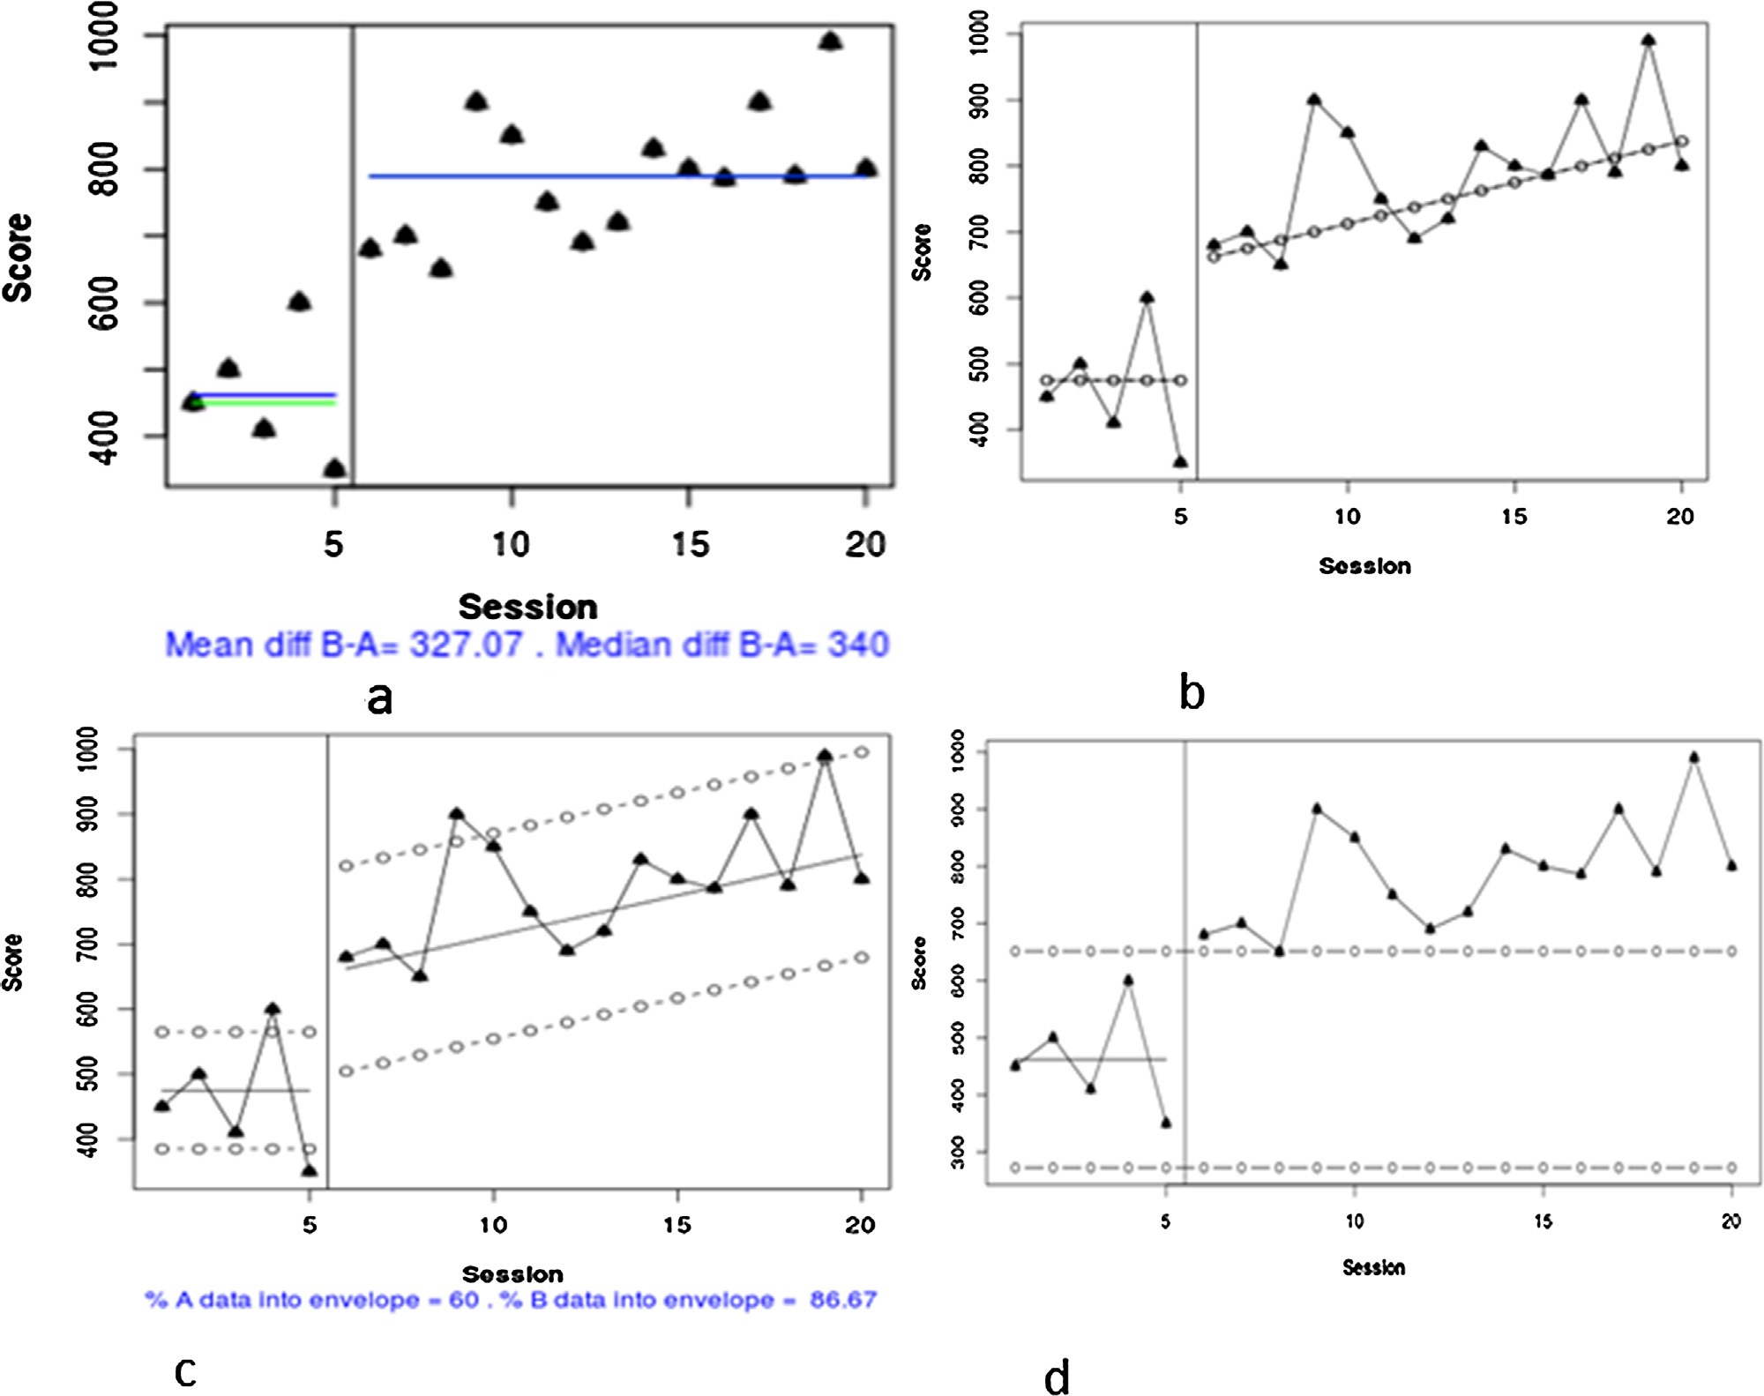
Visual analysis
Add visual aids to help with interpretation
a) Central tendency lines
b) Trend lines
c) Trend line stability bands
d) SD bands/stability lines
Draw a horizontal line at the level of the median/mean of data points in separate phases
Can extend baseline lines into other phases
Assess changes in level between phases – useful for immediate effects
Krasny-Pacini & Evans (2018)

Slide 68
Visual analysis
Add visual aids to help with interpretation
a) Central tendency lines
b) Trend lines
c) Trend line stability bands
d) SD bands/stability lines
Different methods for plotting trends
Split-middle trend line - Draw line connecting the median of each half-phase
OLS regression trend line – Line drawn based on regression equation for each phase
Determine if there are increasing or declining trends in phases
Krasny-Pacini & Evans (2018)

Slide 69
Visual analysis
Add visual aids to help with interpretation
a) Central tendency lines
b) Trend lines
c) Trend line stability bands
d) SD bands/stability lines
Suggested that trend lines only represent the data if 80% of the data points fall within an envelope bands around the trend line
Assess representativeness and robustness of any trends
Krasny-Pacini & Evans (2018)

Slide 70
Visual analysis
Add visual aids to help with interpretation
a) Central tendency lines
b) Trend lines
c) Trend line stability bands
d) SD bands/stability lines
Calculate the mean and SD of each phase and draw bands 2 SD above and below the mean. Extend the bands into the comparison phase.
Assess spread of data points within phases
Krasny-Pacini & Evans (2018)

Slide 71
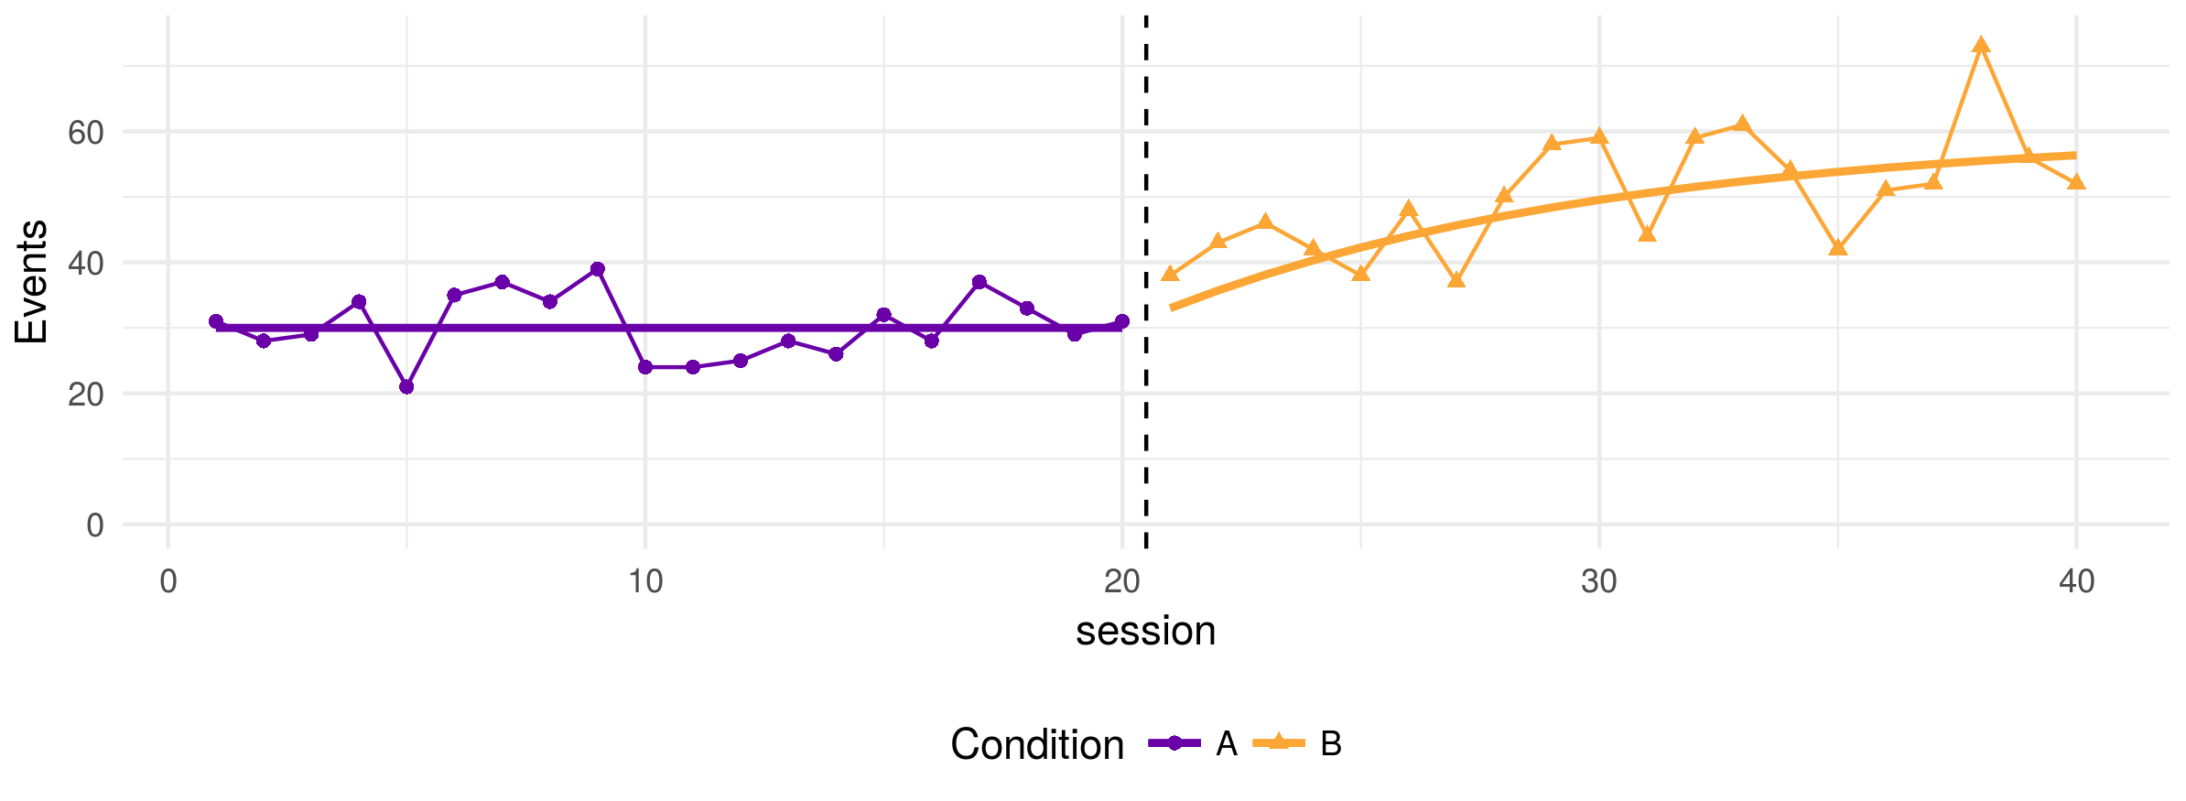
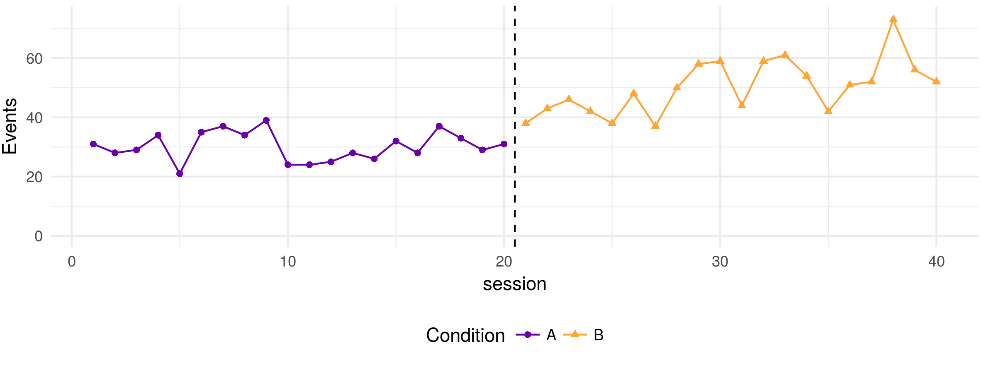
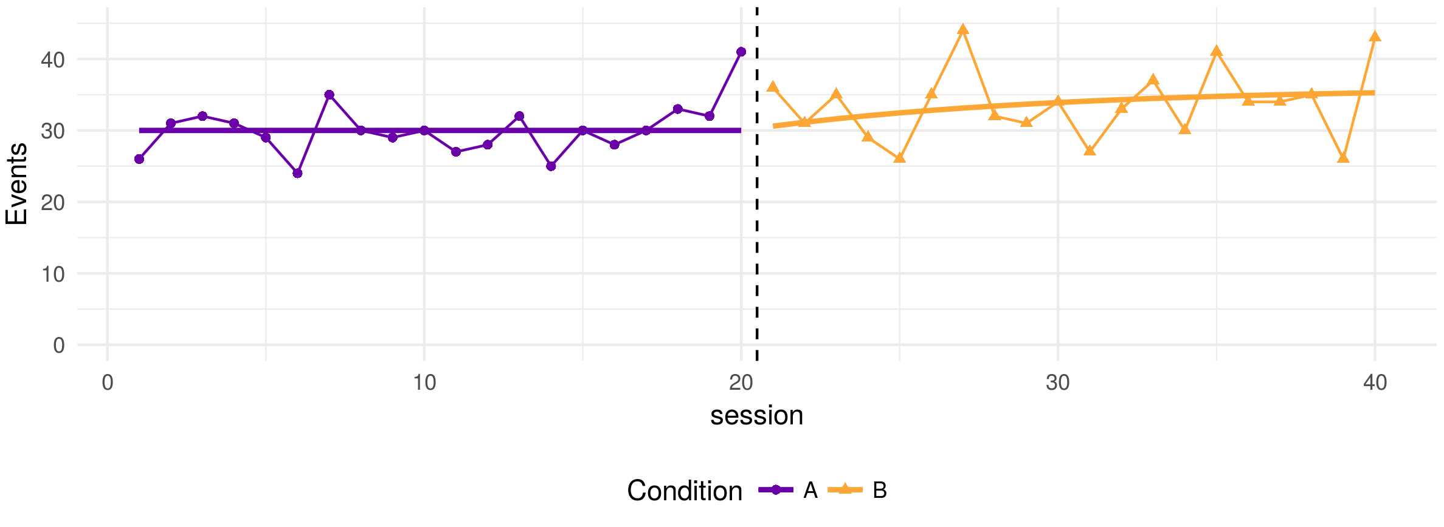
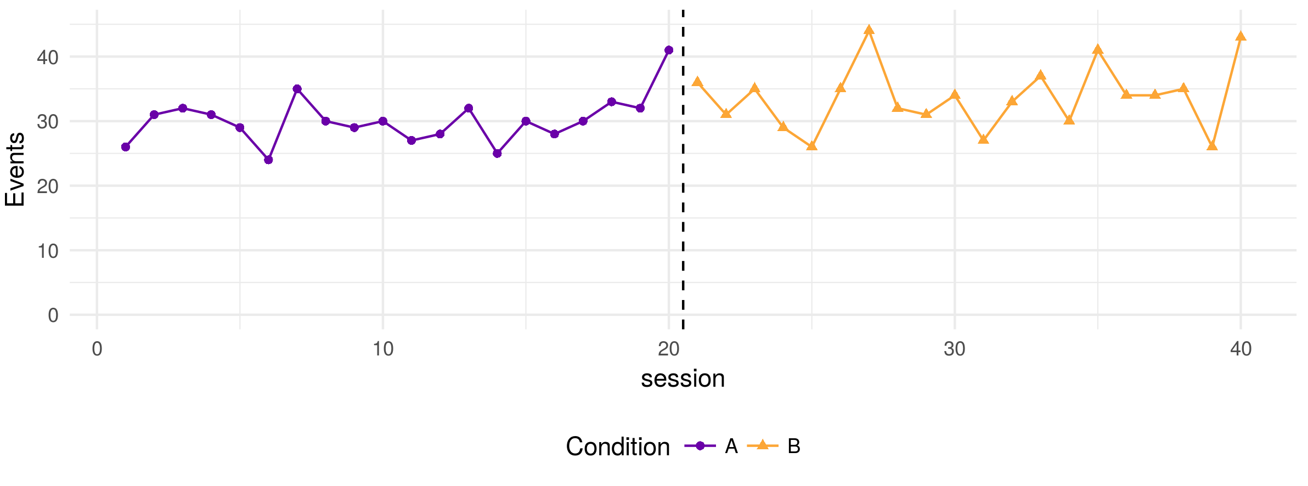
Interpreting visual plots
Interested in amount of overlap between data points in each phase
Less overlap = more likely to be differences between phases i.e. an effect!
Smaller variability within phases – easier to detect effects
Few overlapping data points between phases = intervention has had an effect
Lots of overlap between data points in the two phases – minimal effect of intervention

Slide 72
How to evaluate visual SCED plots?
Cohen et al (2013) Single-Case Research Design in Pediatric Psychology: Considerations Regarding Data Analysis. Journal of Pediatric Psychology, 39, 124-127.

Slide 73
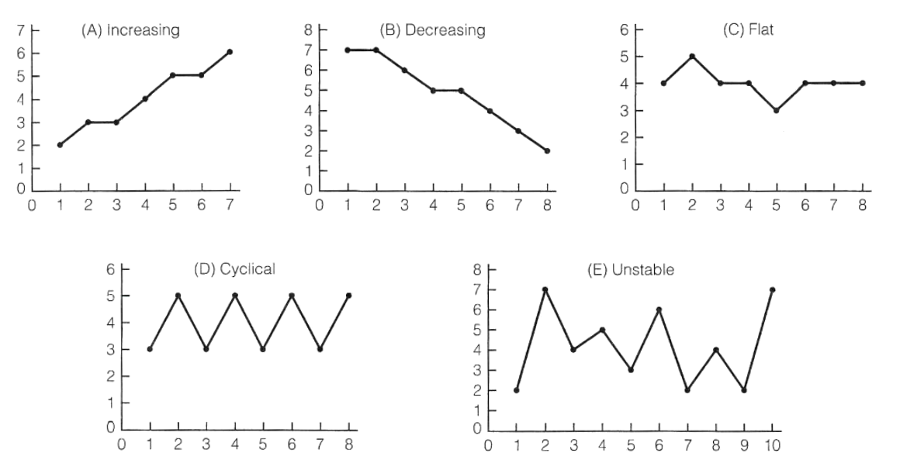
Interpreting baseline trends
Baseline may not be stable – always need to interpret intervention phase in the context of the baseline trend
Statistic that allows us to assess and adjust for baseline trends – more on Tau/Tau-U later
Source: https://www.sjsu.edu/people/fred.prochaska/courses/ScWk240/s1/ScWk-240-Single-Case-Designs-Slides-Week-8.pdf

Slide 74
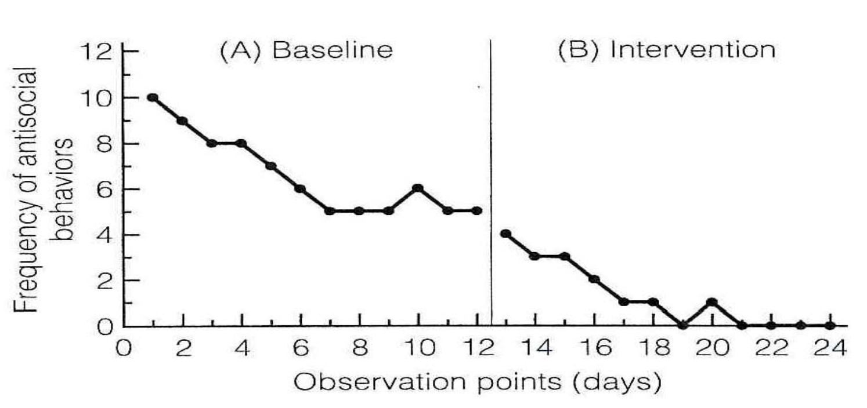
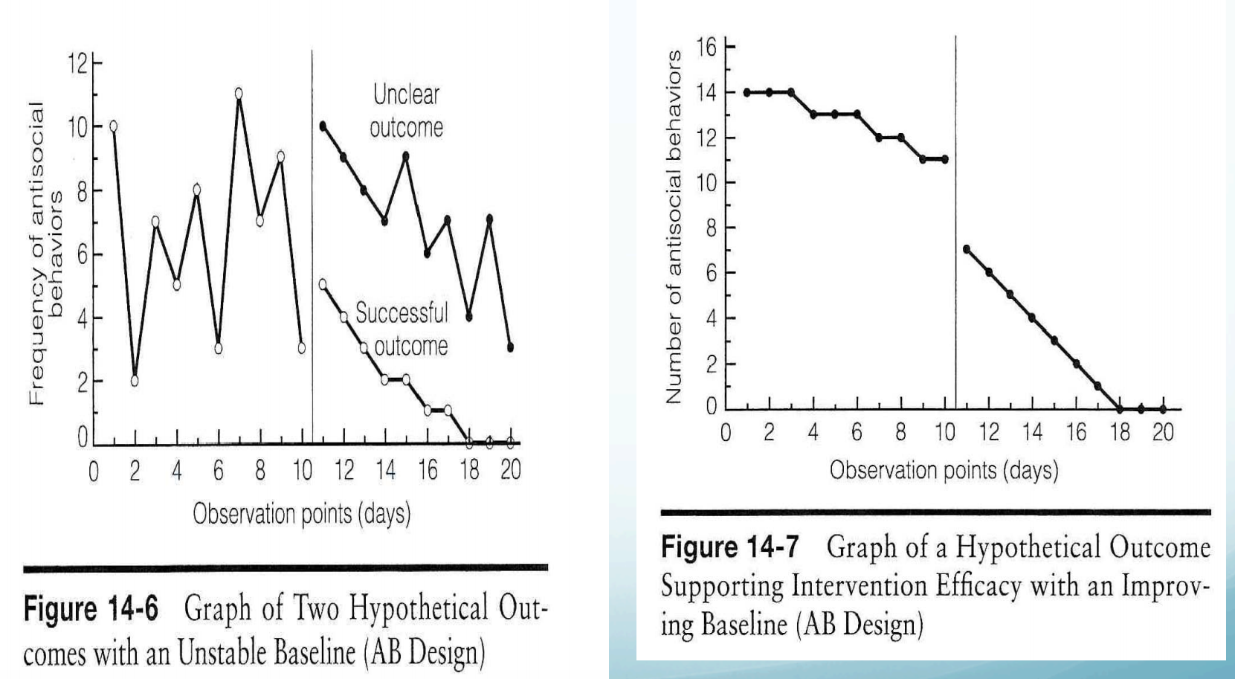
Improvement in the baseline – less of an intervention effect and continued spontaneous recovery?
Need to consider what might be a successful outcome when the baseline has variability or shows improvement
Source: https://www.sjsu.edu/people/fred.prochaska/courses/ScWk240/s1/ScWk-240-Single-Case-Designs-Slides-Week-8.pdf

Slide 75
Statistical analysis Idiographic outcomes
Visual interpretation can be subjective so accompanying statistical analysis can aid interpretation
However need to be aware;
Can be influenced by number of time points/length of baseline
Can be misleading if there is baseline trend
Often difficult to compare
No consensus on best statistical approach/effect size metrics
Statistically significant changes may not have clinical significance
Assumptions of many statistical tests are violated in time-series data (lack of independence caused by autocorrelation)

Slide 76
Why is autocorrelation a problem?
Autocorrelation (also known as serial dependence) is the degree of similarity between one data point in a time series and a previous lagged time point i.e. how correlated are the data points
E.g. Weather is autocorrelated: the noon temperature on a Wednesday is predicted by what the noon temperature was on Tuesday, and to a lesser extent what the noon temperature was on Monday, or Sunday.
Time series data is often autocorrelated – a persons behaviour/thoughts/feelings are not random from day to day so the data is not strictly independent
But most statistical tests are based on the assumption that data are independent
So when autocorrelation is present this assumption is violated and increases the risk of a Type 1 error (false positive)

Slide 77
SCED effect sizes Metrics for capturing between phase differences
Nonparametric (overlap) and parametric (SMD, LOR etc.)
Historic, more commonly reported simple overlap statistics are highly criticised (e.g., PND)
More recently developed overlap effect sizes have improved (e.g. Tau)
Good practice to calculate more than one overlap metric
Remember they are relative to whether the desired direction of improvement is shown by an increase or decrease in the measure
I.e., If desired outcome is increase, number of intervention data points that are higher than the baseline median
If desired outcome is decrease, number of intervention data points that are lower than the baseline median

Slide 78
Non-overlap effect sizes Comparing between phase differences
Common effect sizes | Description *(if an increase is the direction of improvement) | By hand
Percentage exceeding the median (PEM) | Proportion of observations in phase B that improve upon the median of phase A. | Yes
Percentage of non-overlapping data (PND) | *Proportion of observations in the B phase that exceed the highest observation from the A phase. Severe limitations as influenced by no. of time points in the baseline. | Yes
Percentage of all non-overlapping data (PAND) | *Proportion of observations remaining after removing the fewest possible number of observations from either phase so that the highest remaining point from the baseline phase is less than the lowest remaining point from the treatment phase. | Yes
Nonoverlap of all pairs (NAP) | *Proportion of all pair-wise comparisons where the treatment phase observation exceeds the baseline phase observation, with pairs that are exactly tied getting a weight of 1/2. | No
Improvement rate difference (IRD) | The robust phi coefficient corresponding to a certain 2×22×2 table that is a function of the degree of overlap between the observations each phase | No
Tau/Tau-U | Tau provides an effect estimate that does not make any adjustments for baseline trend. Tau-U is similar to Tau but includes an adjustment for baseline trends. | No

Slide 79
Example: Percentage exceeding the median (PEM)
Calculate median of baseline
=3
Count number of intervention phase datapoints that are above the median
=37 out of 42
Convert to a %
37/42*100 = 88.10%
PEM=88.10%

Slide 80
Example: Percentage of all non-overlapping data (PAND)
Count how many extreme datapoints would need to be removed to there is no overlap
=6 (red circles)
Convert to %
6/63*100=9.52%
Take the inverse
100-9.52=90.48%
PAND=90.48%

Slide 81
Interpreting non-overlap effect sizes
Effects are provided as a proportion (or *100 to make a %)
The larger the effect size, the more effective the treatment
No agreed way to interpret the effect sizes
But Scruggs & Mastropieri (1998) suggested the following interpretation;
> 0.90(or 90%) indicative of a very effective treatment
0.70-0.89 (or 70-89%) represent moderate effectiveness
0.50-0.69 (or 50-69%) are debatably effective
<0.50 (50%) are regarded as not effective

Slide 82
Assessing and adjusting for baseline trend using Tau/Tau-U
Tau/Tau-U family of effect sizes calculates overlap even in highly variable data, corrects for trend and is robust to serial dependency/autocorrelation.
If baseline phases on ideographic outcomes are stable, then Tau (^{τAvsB}) is a better index of outcome, as opposed to Tau-U (^{τ(AvsB)-Atrend}).
Assess whether there is a significant trend in the baseline phase (Tau ^{trend A})
If there is a significant baseline trend (p<.05), then an adjustment can be applied – corrects for the baseline trend for comparisons across phases
Calculate the Tau effect size for the difference between phases, either based on the corrected (Tau-U ^{τ(AvsB)-Atrend}) or uncorrected data (Tau ^{τAvsB}).
Online Tau calculator: http://ktarlow.com/stats/tau/ or Overlap Shiny app: https://manolov.shinyapps.io/Overlap/

Slide 83
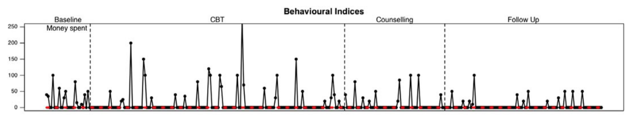
Comparing multiple phases
If you have more than two phases (i.e. any design other than A/B) then do pairwise comparisons of effects for each phase where it is of interest to see if there is a difference
E.g. AB-F/U design
Baseline (A) vs intervention (B)
Baseline (A) vs follow-up (FU)
See example published papers of different designs in your pack

Slide 84
Assessing nomothetic outcomes
Supplement the idiographic findings by evaluating whether pre/post phase scores on nomothetic measures meet criteria for reliable and clinical significant change (Jacobson & Traux, 1991)
Has the client shown reliable change (RC) - a reduction in scores that exceeds a change that could be due to measurement error
Use the reliability (Cronbach’s Alpha) of the measure and non-clinical and clinical. norms to calculate the amount of change that would be considered reliable
Has the client shown clinically significant change (CSC) – moved from above to below a clinical cut-off threshold
Can use defined clinical cut-off’s if available for the measure or can use clinical and non-clinical norms to calculate a threshold.
Bear in mind that process or generalisation measures may not make conceptual sense to assess clinically significant change (e.g. activation or quality of life)
An Excel workbook & manual is provided in the Resource Pack that will allow you to do this!

Slide 85
Evaluating nomothetic outcomes using reliable & clinically significant change
Nomothetic measure of general distress: CORE-OM
Connell et al (2007) paper reports psychometric evaluation including;
Reliability of the measures (Cronbach’s Alpha = 0.91)
Clinical and non-clinical norms (mean & SD)
Established reliable change and clinical cut-off thresholds
Pre-post change >= 6 shows Reliable Change
Pre-post score moving from above to below 10 shows Clinically Significant Change

Slide 86
What do you need to include in your assignment?
VISUAL ANALYSIS
Visual plots of every idiographic measure
Include phase trend lines and baseline median line
SUMMARY DESCRIPTIVES
Report means & SDs for each idiographic measure in each phase
STATISTICAL ANALYSIS
Assess for baseline trend (appropriate Tau correction if trend is present)
Report at least 3 non-overlap statistics
Assess autocorrelation in data (instructions provided in resources)
NOMOTHETIC OUTCOMES
Calculate whether RC and CSC have occurred for the primary nomothetic measure (main symptom or distress measure – CORE-OM?).
For the other nomothetic measures calculate RC and if relevant, calculate CSC.

Slide 87
Deciding what software to use
Data input and management: Excel
Lots of the analysis can be done by hand (if you want)
More sophisticated techniques require software/web calculators (they will also do the simpler analyses/visualisation as well!)
See SingleCaseSoftware table for summary of some of the available programs/web calculators for SCED analysis
What you can do in each program
Benefits and limitations of each program
Complexity to learn

Slide 88
Quick intro to SCED software
Microsoft Excel
Tau online calculator: http://ktarlow.com/stats/tau/
Jepusto Shiny app: https://jepusto.shinyapps.io/SCD-effect-sizes/
SCDA Shiny app: https://tamalkd.shinyapps.io/scda/
Overlap Shiny app: https://manolov.shinyapps.io/Overlap/

Slide 90
SCED Resource Pack

Slide 91
Practical task – have a go at SCED analysis
We will divide you into groups of 4
Two example datasets – each group will be assigned a dataset
Adult mental health setting (AB-F/U)
Adult inpatient setting (AB)
Each has a guide to walk you through conducting and reporting the analysis in different types of software
There are multiple idiographic measures – you don’t have to do all of them in the practical – the examples are provided so you have a guide for the full analysis process you will need to do for your assignment
You may want to divide the measures up between your group

Slide 92
Feedback your findings
Feedback–informal overview of findings (~5-10 mins per group)
Things to report on;
Visual plot of each idiographic measure
Assess whether there is a baseline trend using Tau/Tau-U
Calculate x3 non-overlap statistics (Tau/Tau-U counts as one!)
Descriptive statistics for each phase (means and SDs)
RCSI analysis of nomothetic outcomes
PowerPoint template provided to copy and paste your results into!
Don’t worry too much about having a detailed interpretation!
This is about getting you to practice having a go so we can troubleshoot any problems now and a way of showing the different resources and what they are able to do
Plus each dataset has a summary of the results so you can sense check if you have produced the same findings – just don’t cheat!

Slide 93
Feedback
How did you find using the different SCED software?
Any problems?
Any questions/queries?
Anything you are concerned/unsure about?

Slide 94
References
Cohen et al (2013) Single-Case Research Design in Pediatric Psychology: Considerations Regarding Data Analysis. Journal of Pediatric Psychology, 39, 124-127.
Krasny-Pacini & Evans (2018) Single-case experimental designs to assess intervention effectiveness in rehabilitation: A practical guide. Annals of Physical and Rehabilitation Medicine, 61, 164–179

